Slide 1
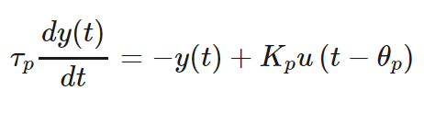
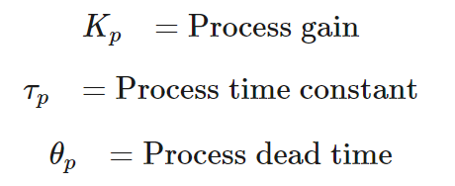
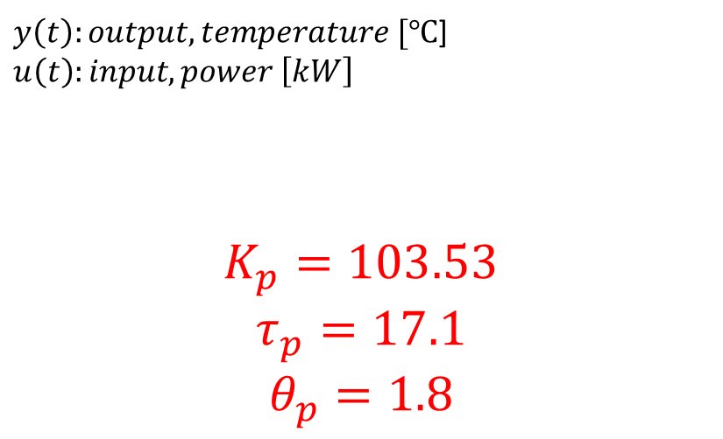
FOPDT: Friction Stir Welding
$y\left(t\right):output, temperature [℃$]$u\left(t\right):input, power \left[kW\right]$
$$K_{p}=103.53$$
$$τ_{p}=17.1$$
$$θ_{p}=1.8$$

Slide 2
Relay Tuning

